Slide 1
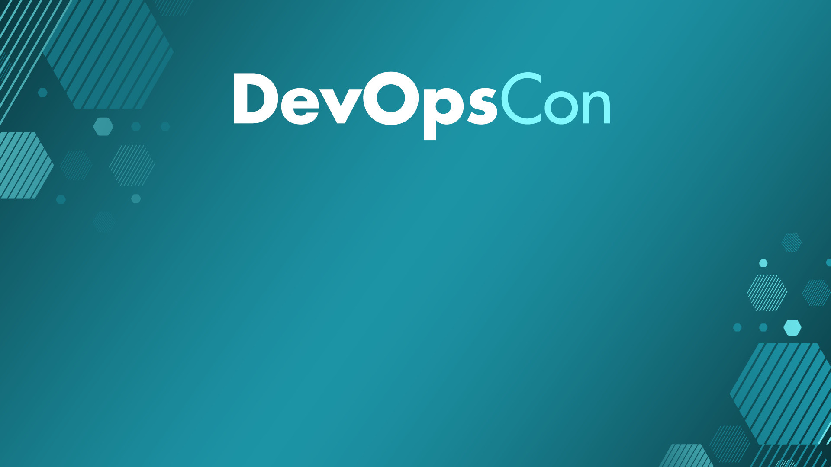
Let’s go Hybrid! Is it better? No. Is it cheaper? Yes!
Roberto Freato – Azure MVP / Author / CTO @Witailer

Slide 2
Agenda
What’s a Data Platform
Ingestion
Experimenting
Storage
Processing

Slide 3

Disclaimer
Prices used in this presentation are only indications.
Actual pricing can depend on a huge variety of factors which are out of the scope of this session.
I’m not affiliated with any cloud/hosting provider.
In this session, the term “hybrid” is abused, to mean almost everything except single public cloud, like running multi-cloud, or running bare metal or even with a mix of an ARM-based K8S cluster on your desk. Sorry about that.

Slide 4

Do you know the cost of a core?
Per month, in the mainstream public cloud

Slide 5
30$ / month*
* details of calculation method and providers can be provided privately
“Major” public cloud

Slide 6
12$ / month*
* details of calculation method and providers can be provided privately
“Cheap” public cloud

Slide 7
8$ / month*
* details of calculation method and providers can be provided privately
Bare metal (managed)

Slide 8
To be honest about Main differences between providers
Provider | SLA | Network | Regions | Bandwidth
Major cloud | Always | Advanced | Many | Pay-per-use
Cheap cloud | Sometimes | Limited | Few | Pay-per-use (cheaper)
Bare metal (managed) | DIY | Basic / None | Few | Flat included

Slide 9
I started cloud-native
Notes:
Growing fast is a great fit for startups

Slide 10
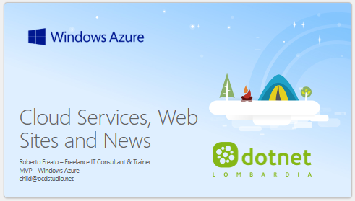
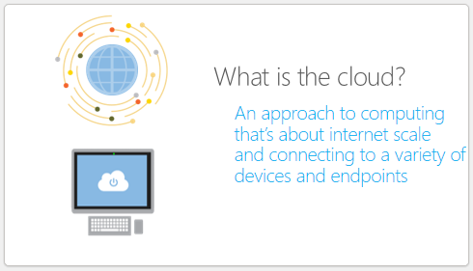
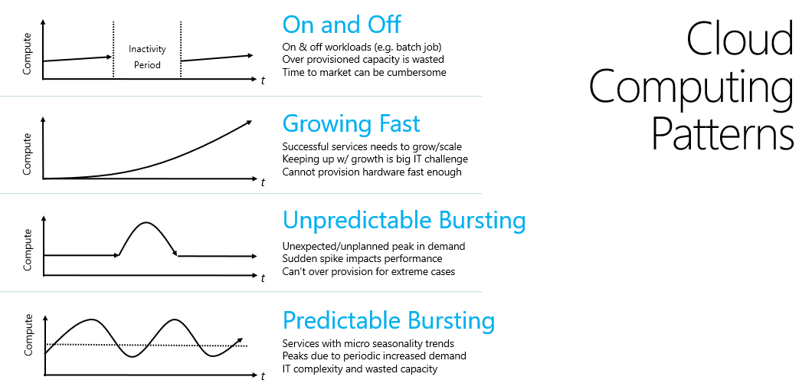
Let’s step back 11 years ago*
* Web.NET Conference @Milan – 10/20/2012

Slide 11
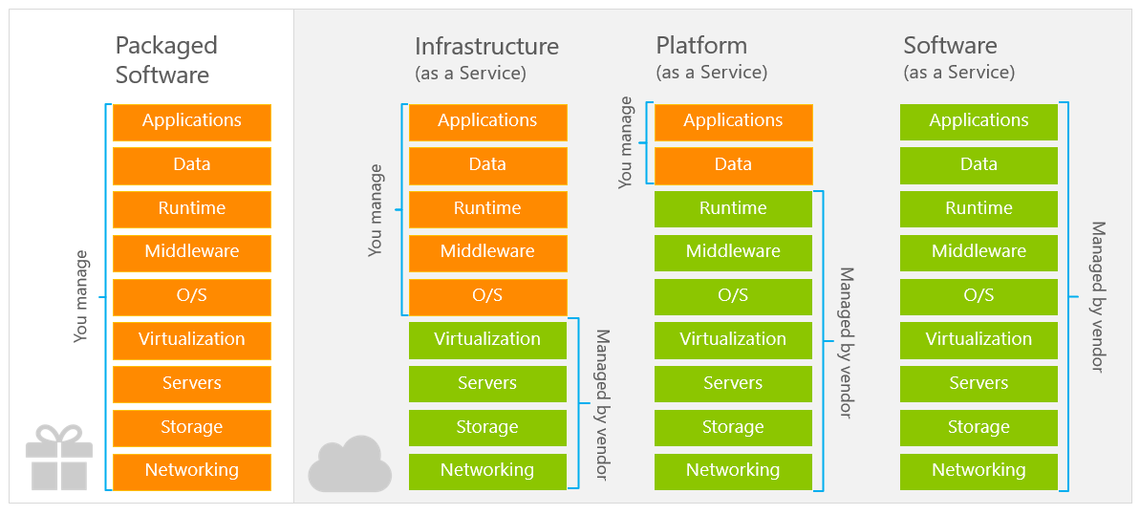

Slide 12
Not every company is a startup
tip #1
Notes:
Growing fast is a great fit for startups

Slide 13
On and Off
Cloud Computing Patterns
Inactivity
Period
On & off workloads (e.g. batch job)
Over provisioned capacity is wasted
Time to market can be cumbersome
Compute
t
Growing Fast
Compute
Successful services needs to grow/scale
Keeping up w/ growth is big IT challenge
Cannot provision hardware fast enough
t
Unpredictable Bursting
Compute
Unexpected/unplanned peak in demand
Sudden spike impacts performance
Can’t over provision for extreme cases
t
Predictable Bursting
Compute
Services with micro seasonality trends
Peaks due to periodic increased demand
IT complexity and wasted capacity
t

Slide 14
Focus on value*-added services
* value is very often represented by software
tip #2

Slide 15
Azure Functions
Azure Functions
Azure Web Sites
Cloud Services
WebJobs SDK
Serverless
Web Apps
WebJobs
Web Role
Worker Role

Slide 16
Why software adds value to the cloud
A set of VMs is just a set of VMs
A set of VMs with a managed installation of Elastic Search can be sold as a Search Service
A NAS is just a storage array
A NAS with a software layer providing an API on it can be sold as an Object Storage

Slide 18
SQL Database
SQL Server as a service
App Service
Deploy web apps
Event Hub
Kafka-like event processor
Scale in seconds
Integrated build service
CronJobs
Multi-protocol
Persistent
Backups, PITR
Scalable
Automatic tuning
some great paas
Notes:
Absolute vs Relative measurements
Gigs? TBs? Per day/month?
It is not a matter of complexity of the dataset itself, but the overall solution
Some sources can be trusted, some others not

Slide 19
Azure AD/B2C
IAM as-a-service
Synapse
Single point for a Data solution
Container Instances/Apps
Docker runner as a service
Spark integration
Pipelines
Data lake
Data warehouse
Scalable on events
Ready-to-go
Billed on Users/MAU
Multi-protocol
some great paas (2)
Notes:
Absolute vs Relative measurements
Gigs? TBs? Per day/month?
It is not a matter of complexity of the dataset itself, but the overall solution
Some sources can be trusted, some others not

Slide 20
API Management
API Router/Proxy
Logic Apps
Workflow management
Storage
Many ready-to-use connectors
Billed on consumption
Indefinite-scalable archive
Multi-protocol
Access Control
Cache
Versioning
Developer portal
some great paas (3)
Notes:
Absolute vs Relative measurements
Gigs? TBs? Per day/month?
It is not a matter of complexity of the dataset itself, but the overall solution
Some sources can be trusted, some others not

Slide 21
Should we avoid the VMs?

Slide 22
Learn how the Cloud does
tip #3
Notes:
Growing fast is a great fit for startups

Slide 23
Some examples
Implement multi-tenancy by design, always
As cloud provider do with your services
Automate every resource creation
By learning the provisioning technology
Focus on optimization and cost-efficiency
As you did with public utilities
Reduce complexity of applications
By forcing you to simplify your apps to fit PaaS

Slide 24
Expected results
Implement multi-tenancy by design, always
Automate every resource creation
Focus on optimization and cost-efficiency
Reduce complexity of applications
You will have fewer deployments, easier upgrade/updates
Resource pooling
You will learn to provision stuff with code/scripting
And you will never come back, either on-prem
A better algorithm will save money in the cloud
You will keep this learnings with you after it
Most of PaaS needs application constraints to run
Those constraints are often good in general in most of the systems

Slide 25
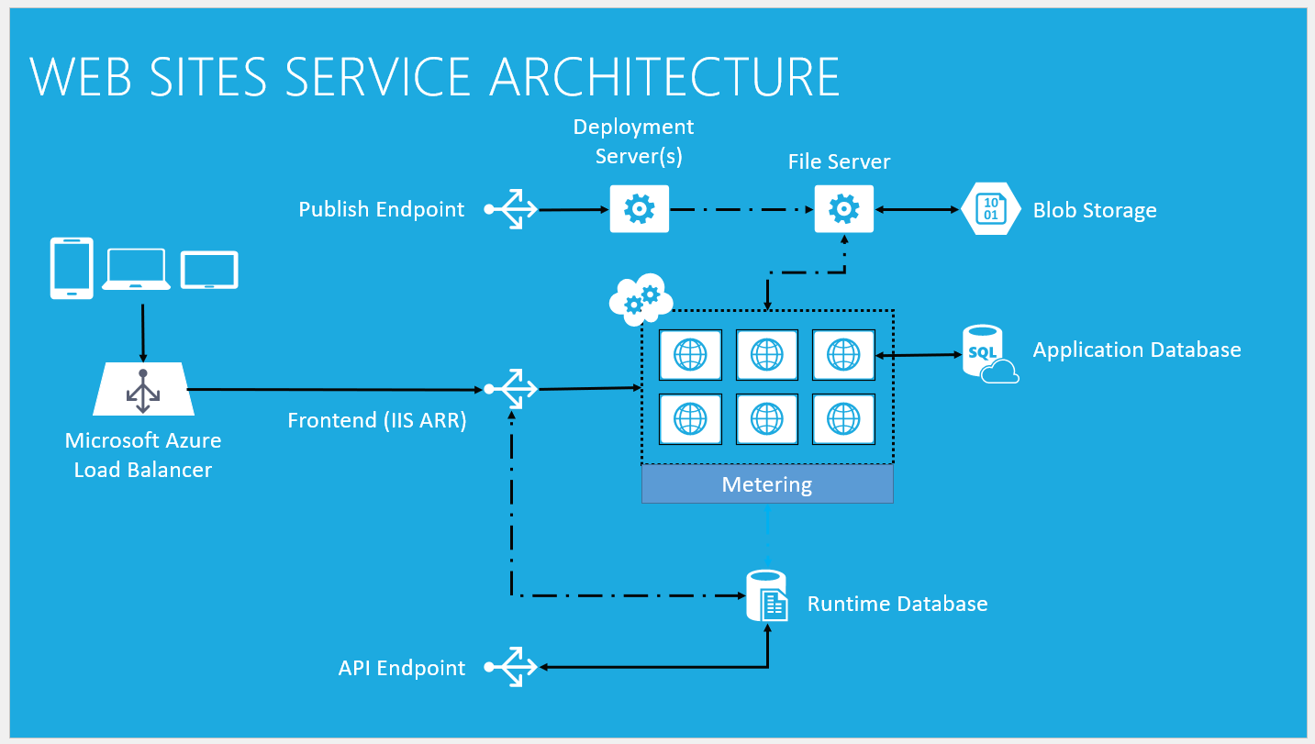

Slide 26
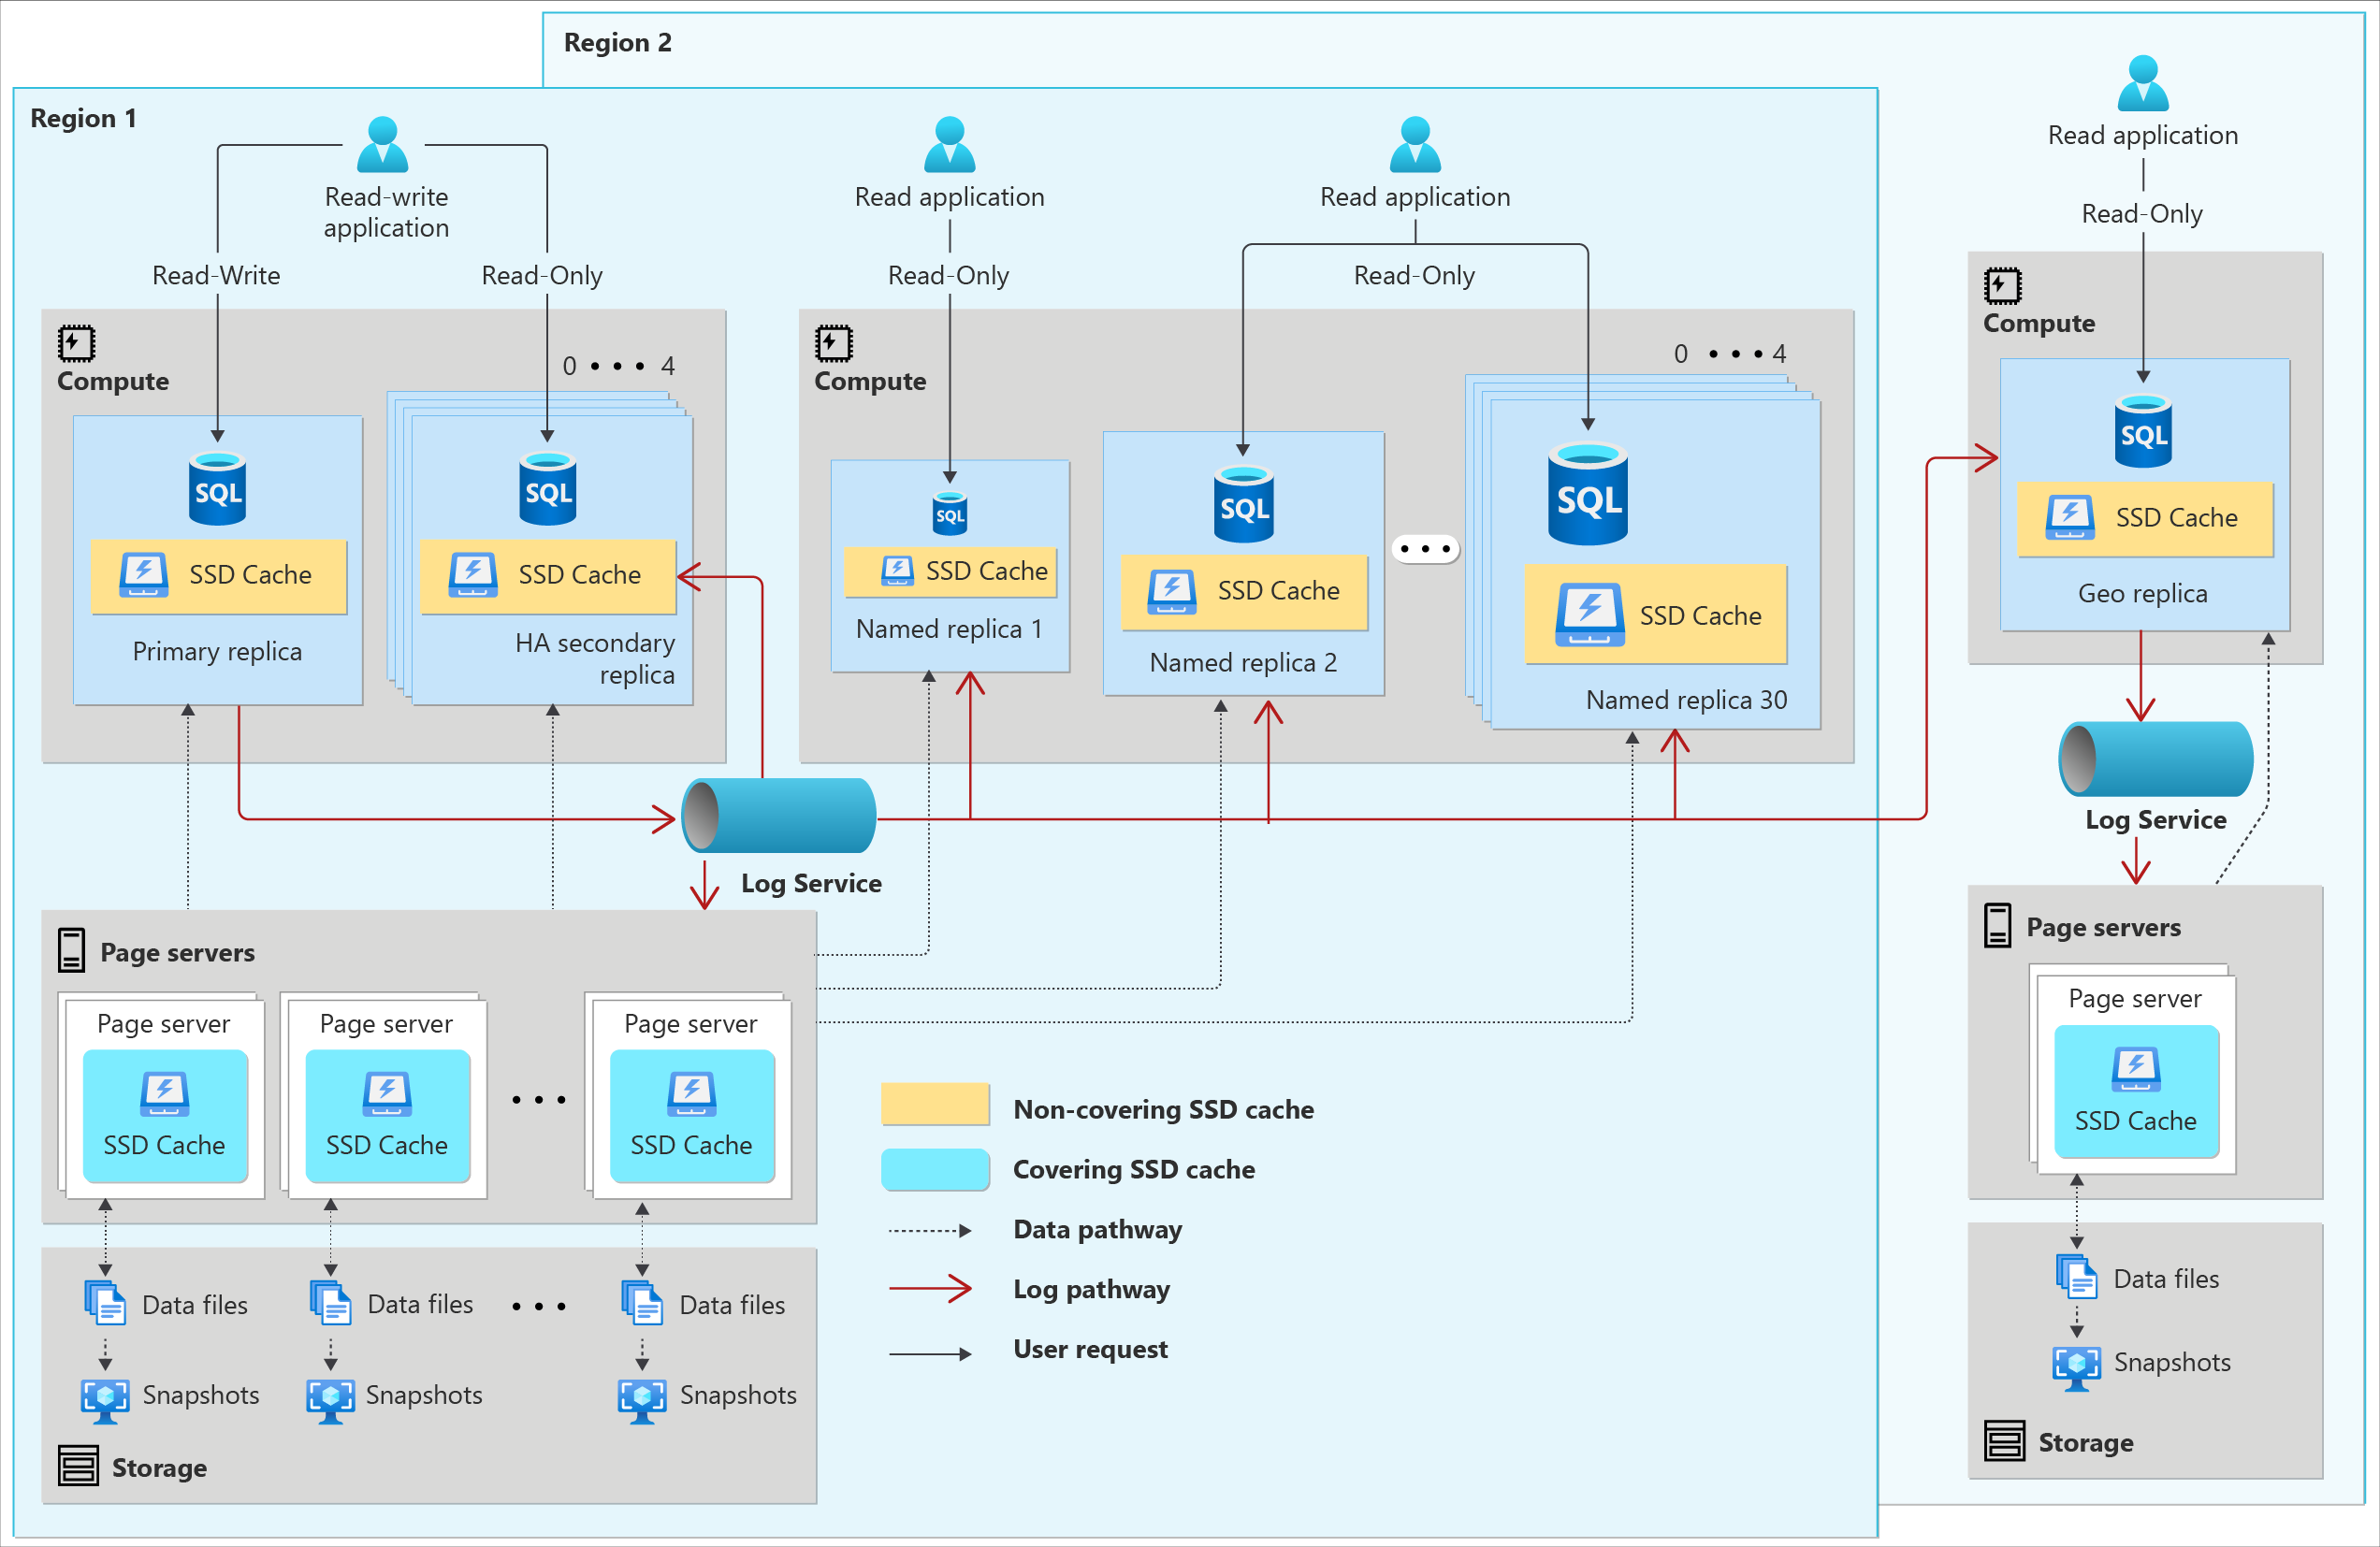

Slide 27
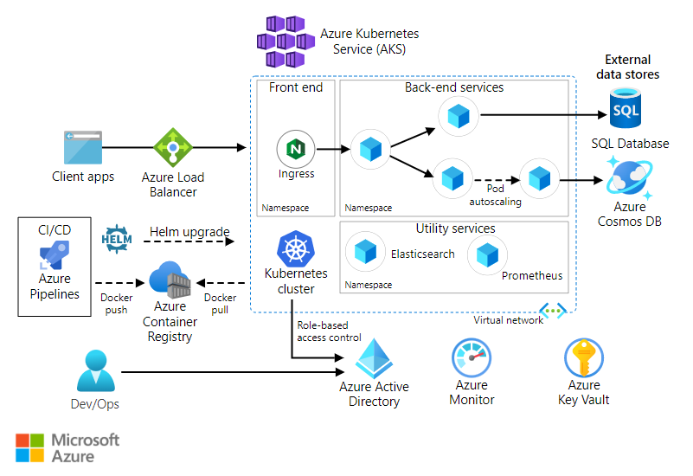

Slide 28
State is the real game changer
tip #4
Notes:
Growing fast is a great fit for startups

Slide 29
Do you know the cost of a TB?

Slide 30
The cost of writing, holding and reading 1TB Take decision with the appropriate information
Access | Frequent | Infrequent | Long-term
Rest | 20 | 10 | 2
Write (10M files) | 54 | 100 | 120
Read (10M files) | 4 | 10 | 6000
Retrieve | 0 | 10 | 24
 | 78 | 130 | 😐

Slide 31
80$ to get out*
* details of calculation method and providers can be provided privately
Know the lock-in

Slide 32
Identify the lock-in(s)
tip #5
Notes:
Growing fast is a great fit for startups

Slide 33
Five shades of lock-in
Get out of a service can cost a lot
The complexity of a service is too hard to manage it directly
The PaaS/SaaS requires custom implementation to fit in
The service represent a really “unique” solution in the market
The individual costs of some services are so “low”

Slide 34
Vital few
Services running 80% of the budget
Try to be locked in (only) here
the cloud services pareto rule

Slide 35
Build your hybrid-PaaS
tip #6
Notes:
Growing fast is a great fit for startups

Slide 36
Bronze
Silver
Gold
Different formats
Much quantity
Consistency is not guaranteed
Data is filtered and cleaned
Quality increases
It is the single source of truth
Data is ready for consumption
Often is aggregated
Can represent a Data Product
Can be the source for other gold
Quantity
Quality
Medallion approach
Notes:
A path from quantity to quality
Reasoning about exposing different layers to stakeholders
Centrality of the Data Product

Slide 37
Batching
Streaming
two conflicting neighbors

Slide 38
Batching fit
we collect events or messages:
an event can be lost, a message no (i.e. an Order)
we are not interested in real-time insights
we can ETL in the plain-old-way
we can manage the late arrivals (and duplicates)
as well as the unordering by-design

Slide 39
“Implement streaming when you really need real-time”
– Me

Slide 40
DEMO
Ingestion and Storage with Event Hubs & Data Lake

Slide 41
We scratched just the surface…
Reacting to Azure Blob storage events | Microsoft Learn
Introduction to Azure Service Bus, an enterprise message broker - Azure Service Bus | Microsoft Learn
Design a PolyBase data loading strategy for dedicated SQL pool - Azure Synapse Analytics | Microsoft Learn
Apache Spark in Azure Synapse Analytics overview - Azure Synapse Analytics | Microsoft Learn
Serverless compute tier - Azure SQL Database | Microsoft Learn
What is Delta Lake? - Azure Synapse Analytics | Microsoft Learn

Slide 42
Takeaways
Make your choice between Streaming or Batching
Choose the right technology or a blend of many
Evaluate data formats like CSVs, JSONs, Parquets and Delta
Use the Serverless Pool to explore and size your Data Platform
Eventually adopt a dedicated pool or a SQL Database
Explore alternatives before making a huge Data Platform

Slide 43

Questions?

Slide 44
Thanks!
Roberto Freato – Azure MVP / Author / CTO @Witailer

